Slide 1
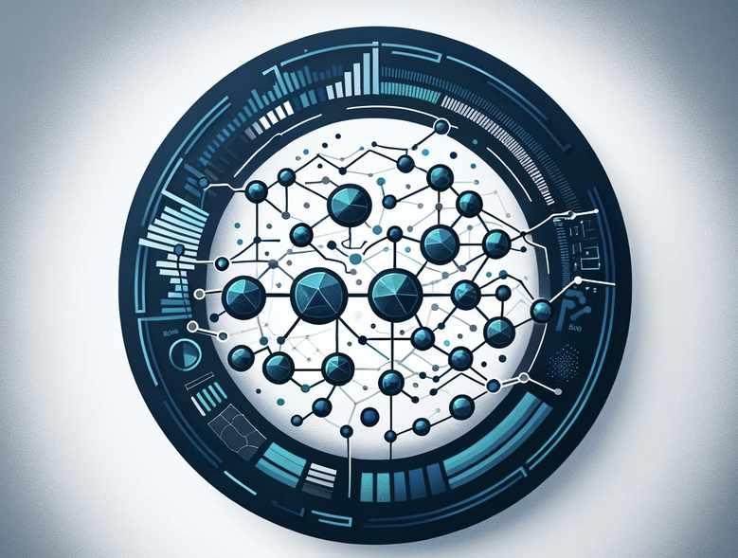
Market Dynamics Simulator: Integrating RAG and LangChain for Strategic Insights
Junaid Yeasir Fahim

Slide 2

Introduction to Market Analysis
Market Dynamics
Forces that impact prices and behaviors in markets

Slide 3
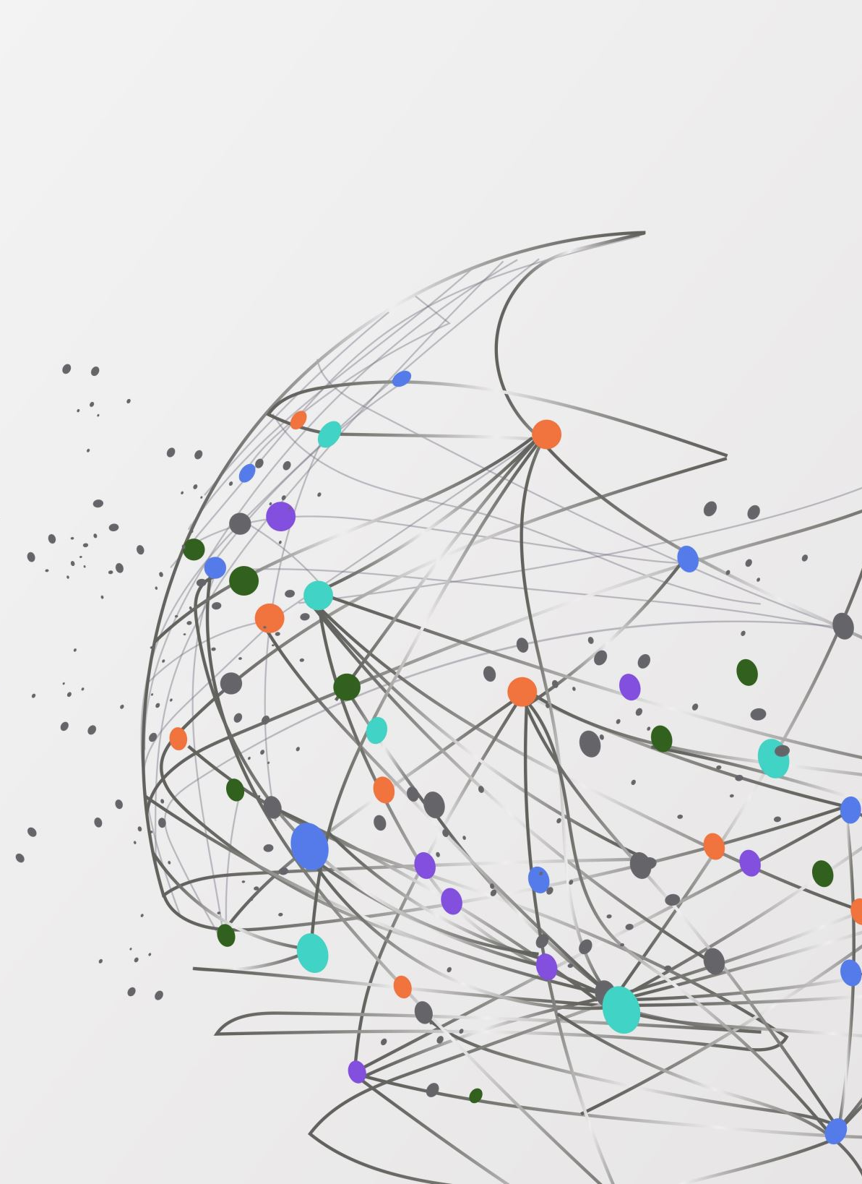
Importance of simulation
Anticipate market changes
Understand competitive strategies
Make informed decision

Slide 4
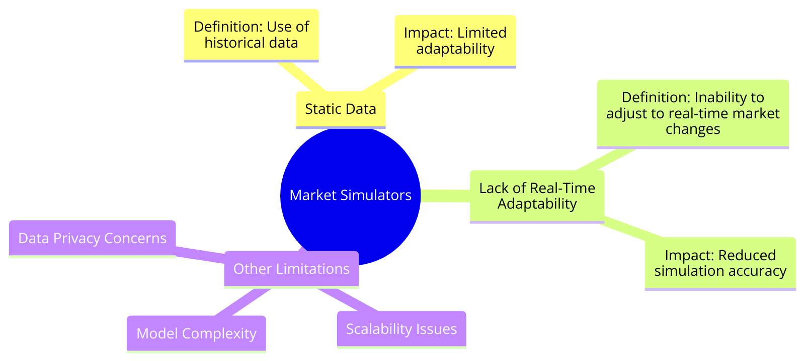
Current limitations

Slide 5



Project Objectives and Scope
To develop a cutting-edge market dynamics simulator that leverages Retrieval-Augmented Generation (RAG) and LangChain for in-depth real-time data analysis and strategic planning.
Dynamic Data Retrieval: provide up-to-date market insights, contrasting with traditional simulators that rely on outdated static datasets.
Autonomous Agent Simulations: Integrating LangChain will allow for the simulation of autonomous agents, offering a more nuanced understanding of market behaviors and competitive strategies.
Application Areas: consulting and sales strategy optimization

Slide 6
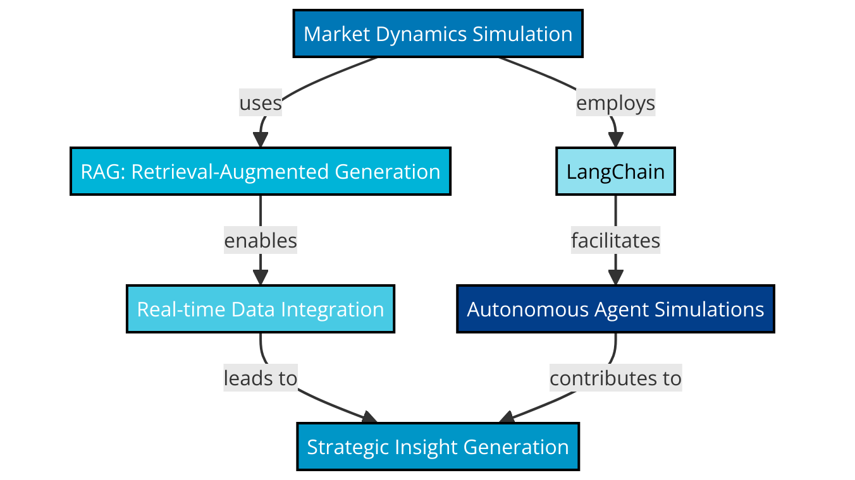

Slide 7
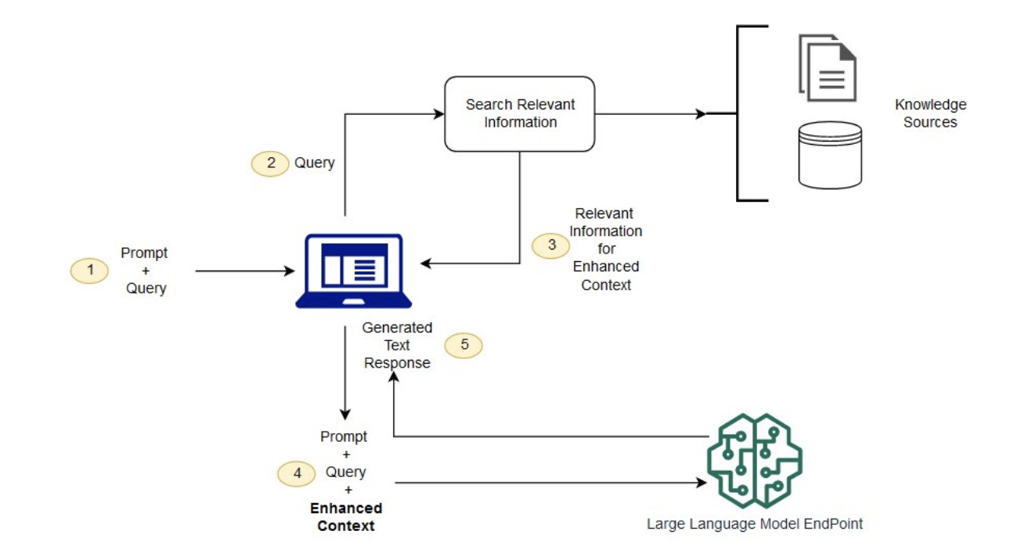
Theoretical Foundation
Retrieval-Augmented Generation (RAG): combines the power of information retrieval and language generation to enhance the quality and relevance of generated text. It works by first retrieving relevant documents or data snippets based on a query and then using a generative model (like GPT or BERT) to synthesize this information into a coherent response.

Slide 8
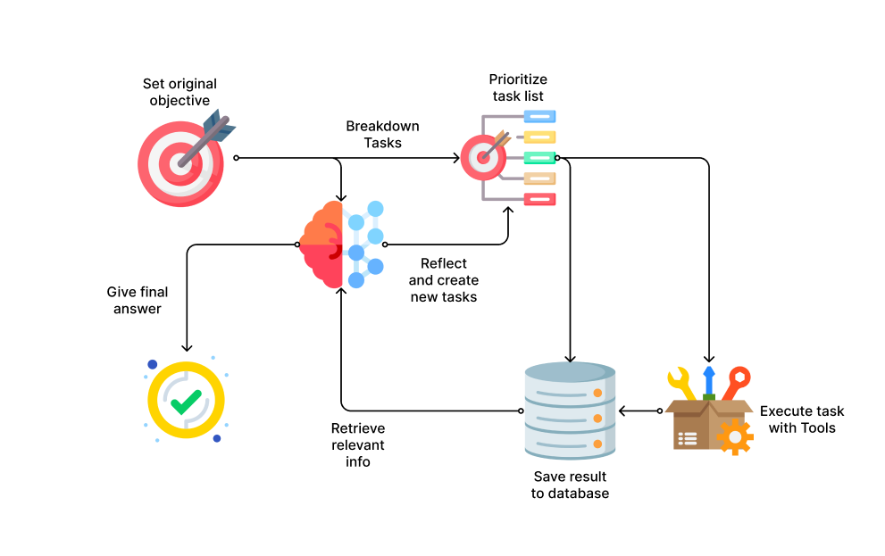
Theoretical Foundation(contd.)
LangChain for Autonomous Agent Simulation: LangChain is a framework designed to facilitate the creation of applications combining language models with structured data and logic. It's particularly suited for simulating autonomous agents that can interact based on AI-generated strategies and responses.

Slide 9
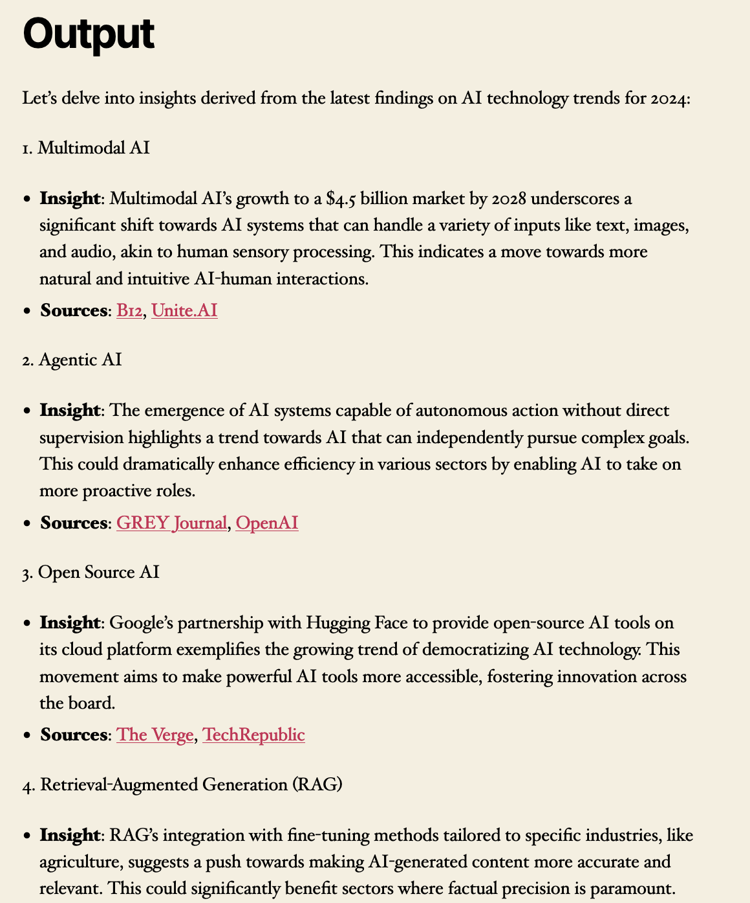
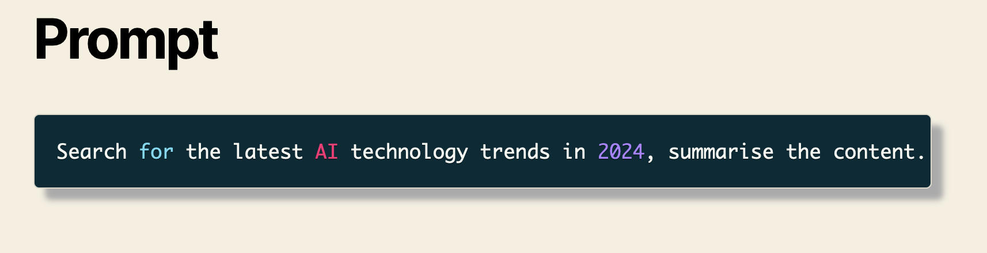

Slide 10
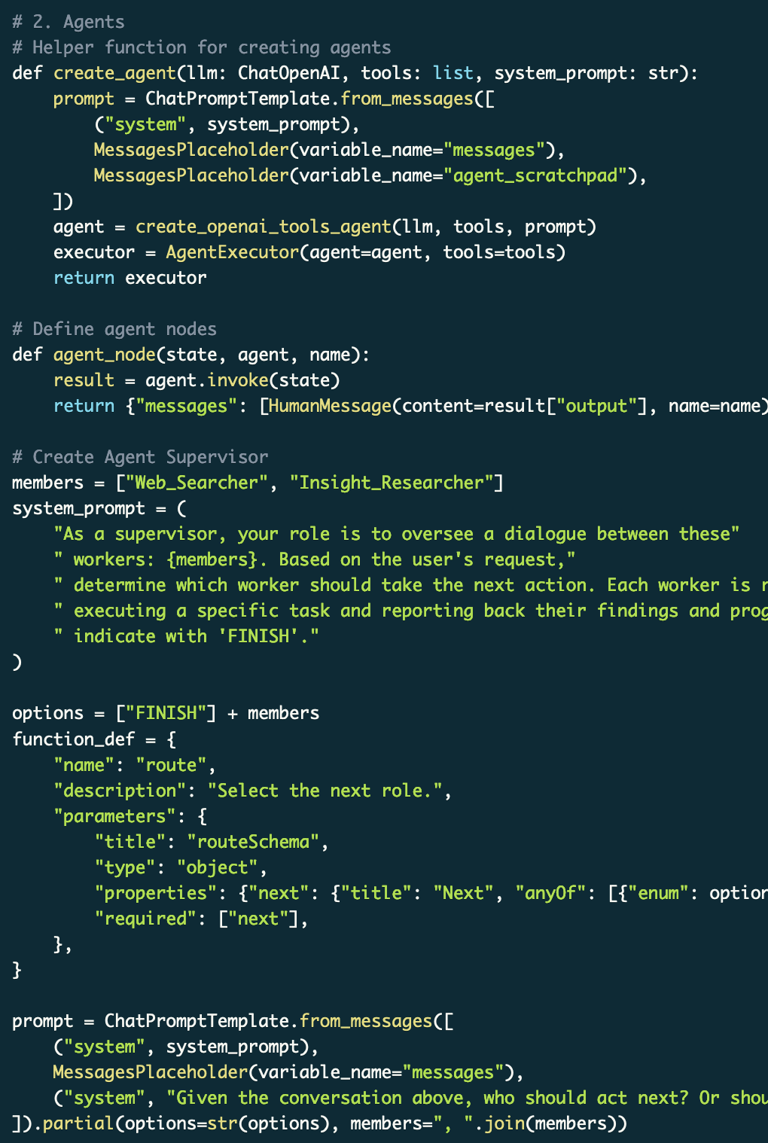

Slide 11

Success Criteria and Validation
Effective Integration
Accuracy in Modeling
Real-time Adaptability
Validations approach:
Historical Data Comparison
Case Studies
Expert Reviews

Slide 12

Requirements
LangChain & LangGraph
Retrieval-Augmented Generation (RAG)
Python: Highlight its use for system integration, algorithm development, and overall simulator functionality.
Data Analysis and Visualization Tools: Pandas, NumPy for data manipulation; Matplotlib, Seaborn for visualization).
System Requirements:
My computer for now

Slide 13

Stakeholders and Resources
Prof. James Skon
Prof. Jon Chun
Me

Slide 14

Timeline
Week 1-2: Initial Preparation and Learning
Gather case studies and secure access to datasets.
Begin exploring LangChain, LangGraph, and RAG.
Set up Python development environment.
Week 3-5: RAG System Development
Integrate RAG with Python for basic data analysis.
Start basic autonomous agent modeling with LangChain.
Enhance simulation with complex agent behaviors.
Week 6-7: Simulation Enhancement
Integrate comprehensive datasets.
Refine agent behaviors based on RAG insights.
Start iterative testing and feedback loop.
Week 8-10: Integration, Testing, and Refinement
Test simulation with case studies.
Refine simulation based on feedback.
Conduct final testing and prepare presentation.

Slide 15

Development Strategy and Equity Considerations
Agile Development Approach:
Flexibility and Adaptation + Iterative Progress
Equity Considerations:
Inclusive Data Analysis: Diverse datasets to avoid biases in market simulation outcomes. Source and validate data to ensure representation.
Bias Mitigation Strategies: regular audits and incorporating feedback from diverse user groups.
Accessibility and Usability: wide range of users, including those with disabilities, through user-friendly design and compliance with accessibility standards.

Slide 16

References
Retrieval-Augmented Generation for Knowledge-Intensive NLP Tasks, https://arxiv.org/abs/2005.11401
Attention Is All You Need, https://arxiv.org/abs/1706.03762

